Slide 1
Simulation
System dynamics
(Business dynamics)

Slide 2
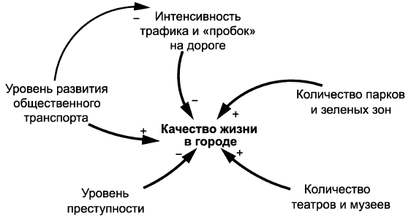

System dynamics
Tools
Causal Loop Diagrams
Stock and Flow Maps
…

Slide 3
Causal Loop Diagrams
CLD

Slide 4
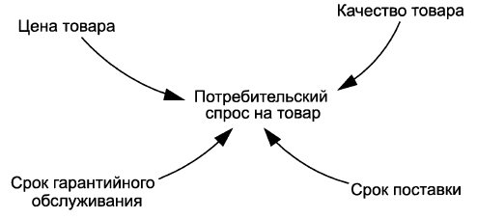
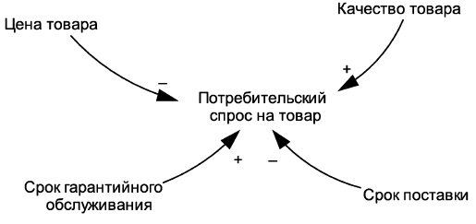
Causal Loop Diagrams
Casual loop diagrams discover how some parameters influence other and themselves.
Parameters or variables
Influences
Signs or directions
of influences

Slide 5
CLD example

Slide 6
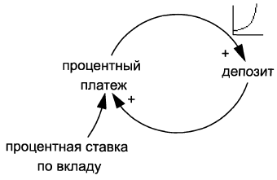
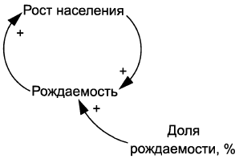
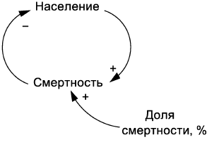
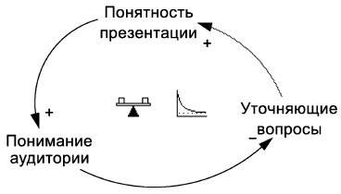
Loops in CLD

Slide 7
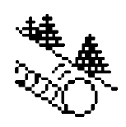

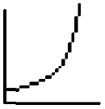
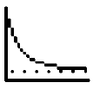
Types of Loops in CLD
Reinforcing (Positive) loops
Balancing (negative) loops
Self-reproducing
Accelerating
Destabilizing
Cause growing
Tending to a goal
Returning to balance
Stabilizing
Prevent growing
R
B
Total number of negative signs in the loop is even
Total number of negative signs in the loop is odd

Slide 8
Types of Loops in CLD

Slide 9
Delays
+
Number of Orders
Number of Delivery

Slide 10
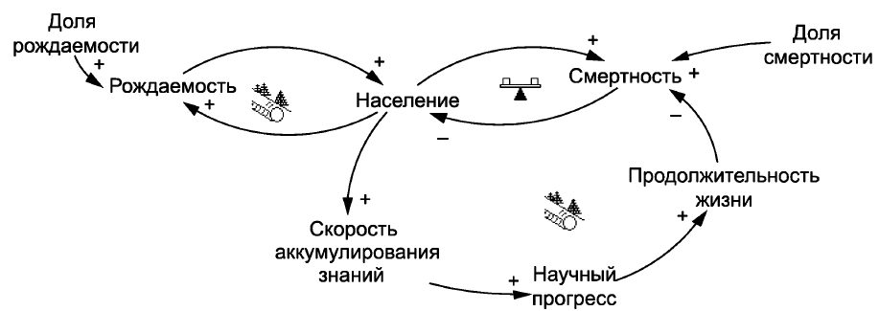
CLD loops example

Slide 11
Stock and Flow Maps

Slide 12
Stock and Flow Maps
Stock and flow maps (stock and flow diagrams, flow diagrams) describe measurable influences of parameters and variables
Basic objects:
some object that is characterized by a certain measurable numerical value that changes over time due to the arrival or departure of a certain amount through the flows
Stock
an object connected to a stock and changing its value. It is characterized by a measurable quantity, which is called rate, speed, or intensity of flow. A flow can contain only one type of objects migrating through it
Flow
Valve
flow control point, the flow rate is calculated here
Source and Sink
stocks outside the system or context under consideration

Slide 13
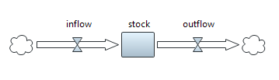
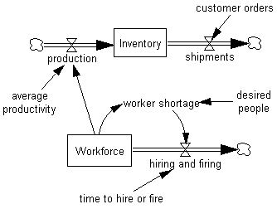
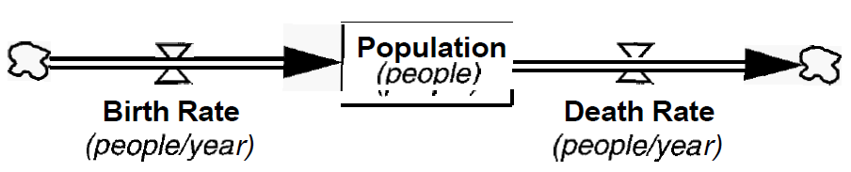
Stocks and Flows examples

Slide 14
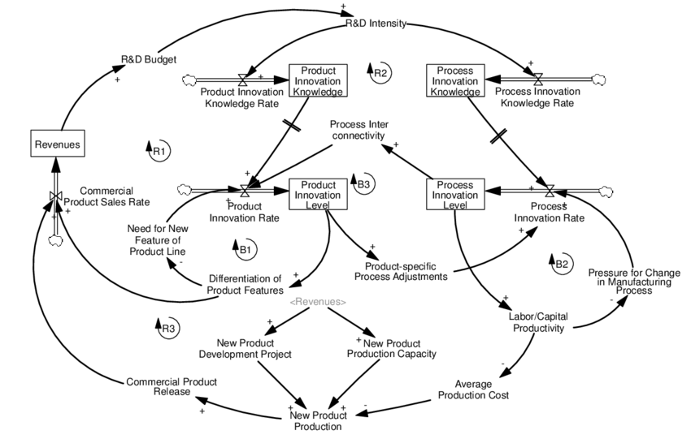
Stocks and Flows examples

Slide 15
Calculations in Stocks and Flows
Continuous model
Discrete model

Slide 16
Stocks and Flows examples

Slide 17
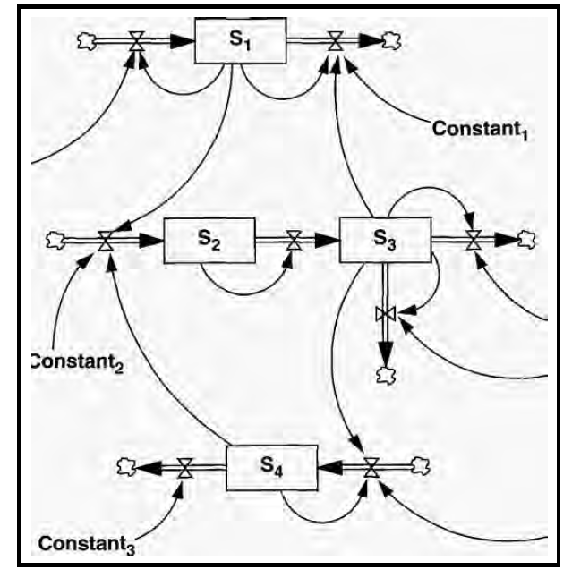
Stocks influence rates

Slide 18
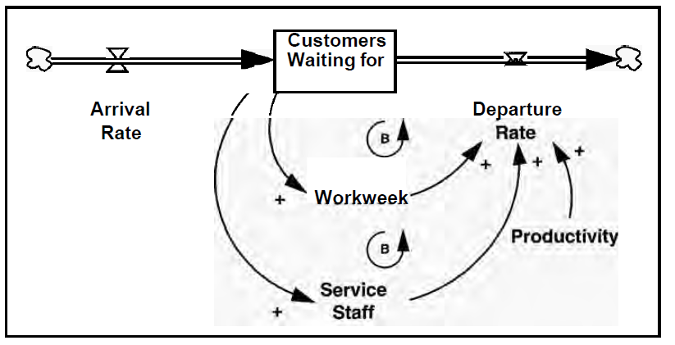
Stocks influence rates
variables
parameters

Slide 19
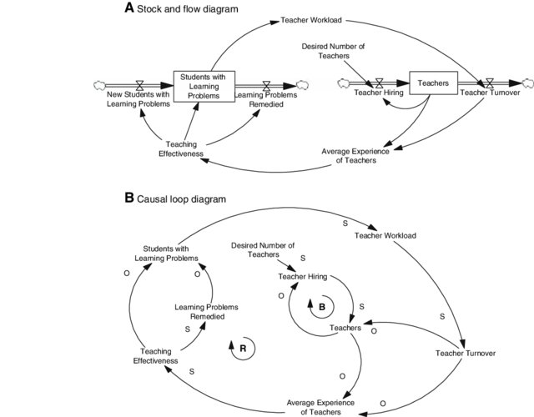
Stocks and Flows vs Causal Loops

Slide 20
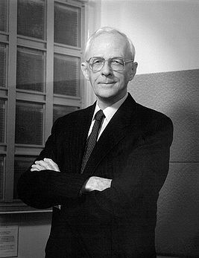
Jay Wright Forrester

Slide 21
Variables and Parameters
Taking values from stocks and flows:
Variable:
name
formula
Stock
level
Flow
Parameter:
rate
name
name, diagram
Variable from another diagram:

Slide 22
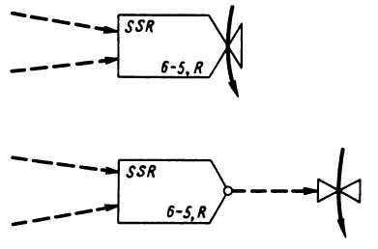
Calculations
A
C
=A+B
B
A
C
(16X)
B
(16X) C = A² + B/4
(6-5,R) SSR = . . .

Slide 23
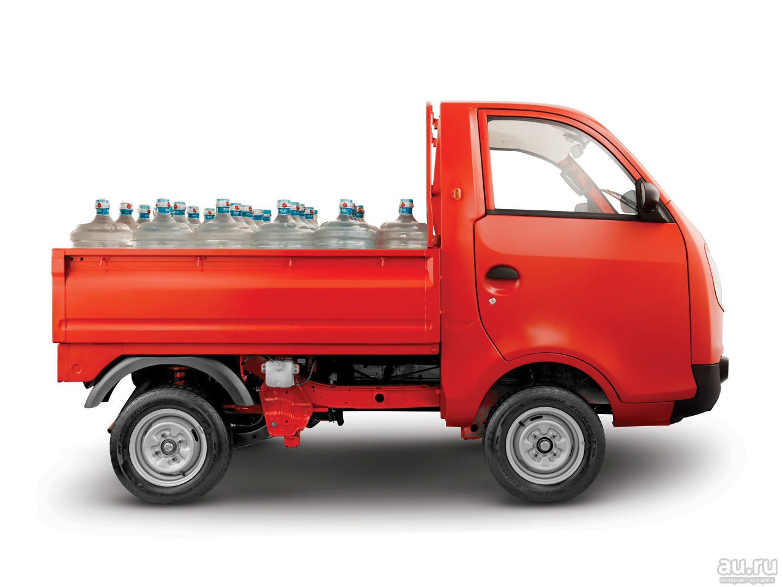
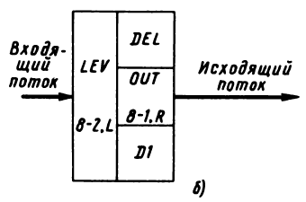
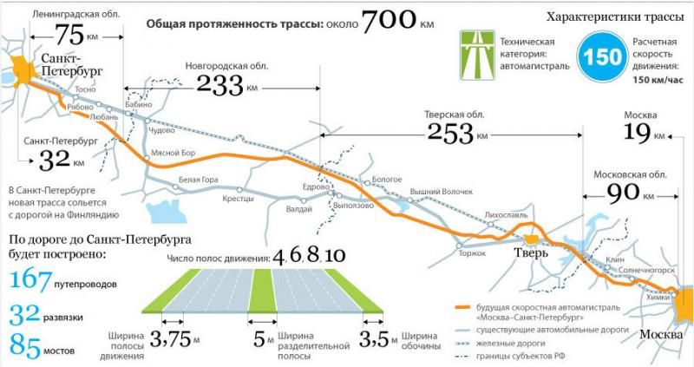
Delays

Slide 24
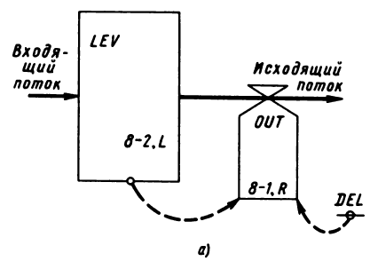

Delays
Delay of order 1 (D1)

Slide 25
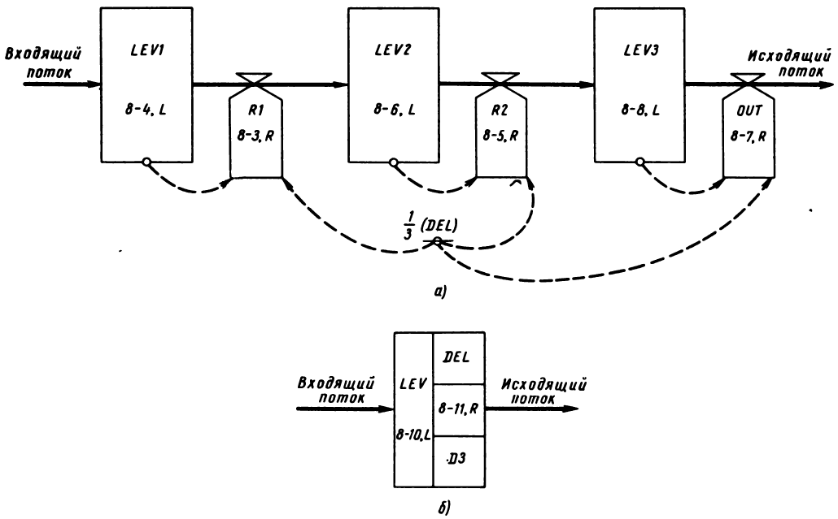
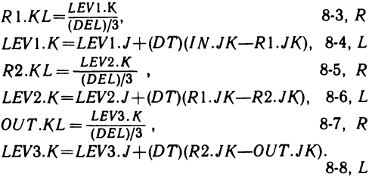
Delay of order 3 (D3)

Slide 26
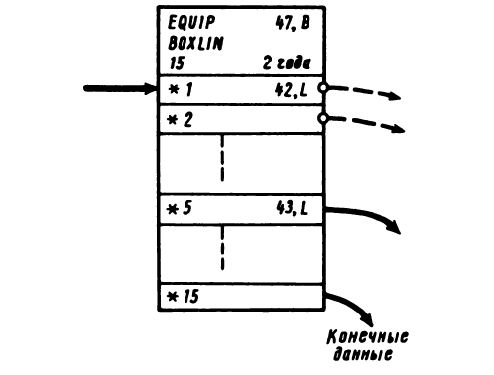
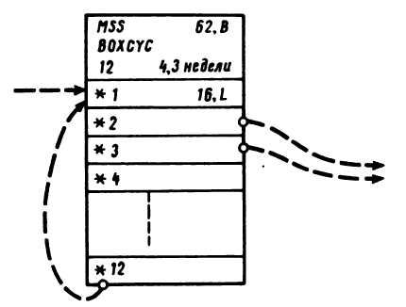
Chain of blocks (boxes)

Slide 27
System Dynamics
Example
Jay Forrester. Industrial Dynamics, 1961

Slide 28
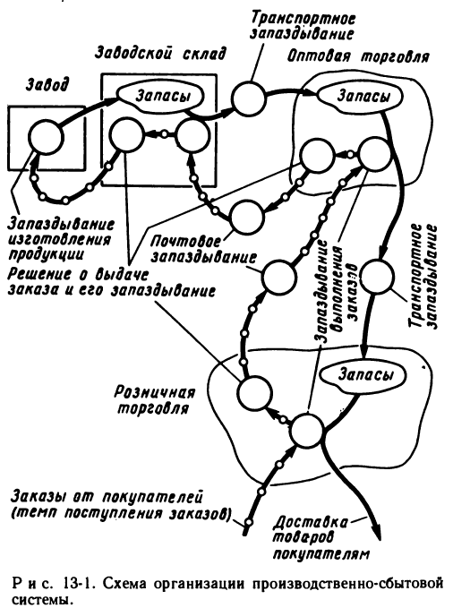

Slide 29
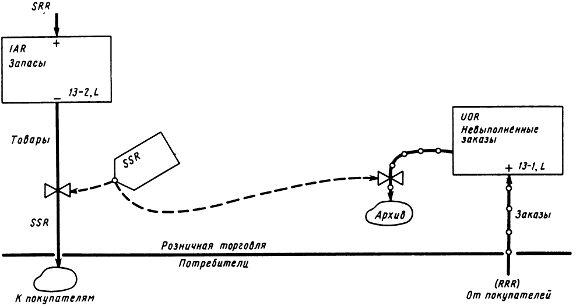
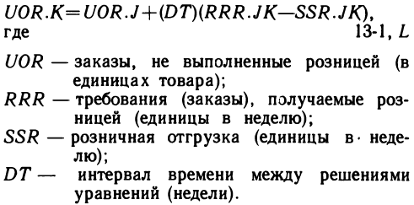
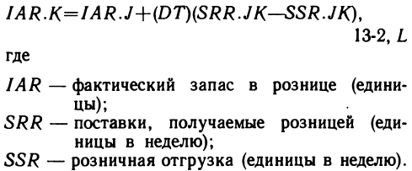
Overview

Slide 30
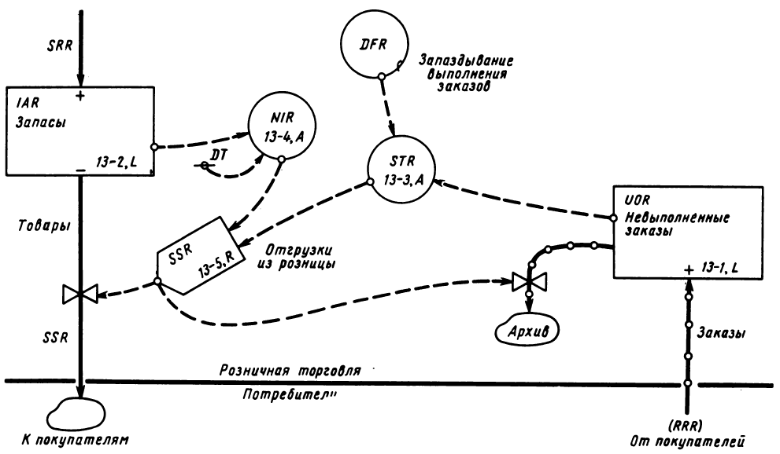
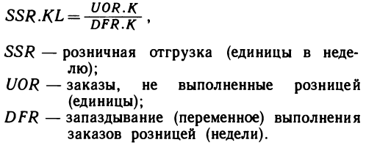
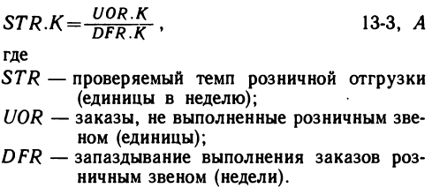
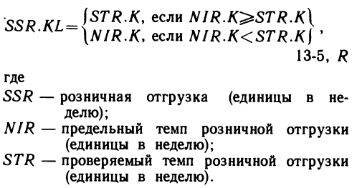
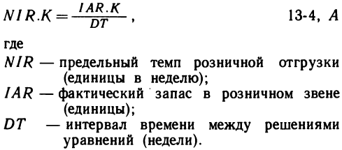
Details

Slide 31
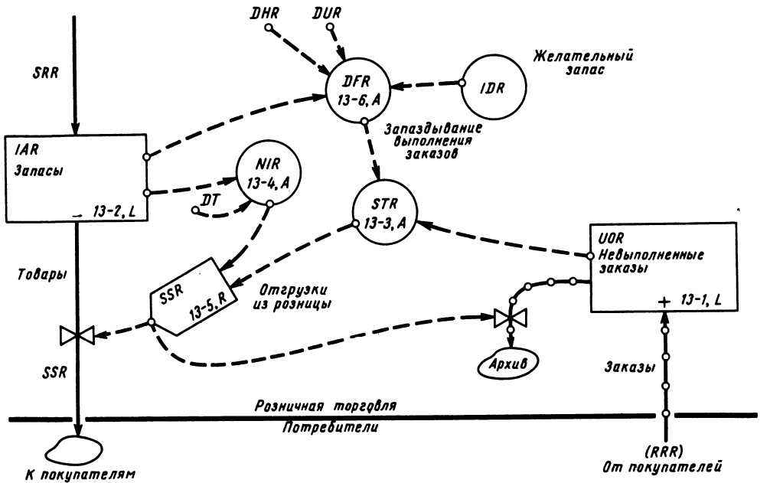
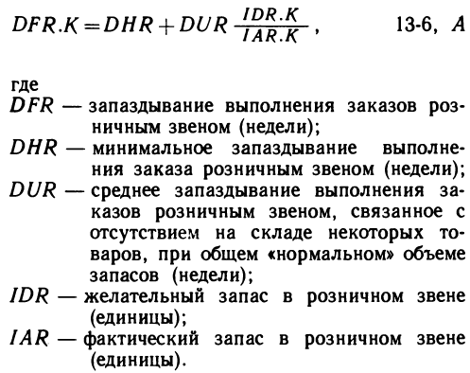
More details

Slide 32
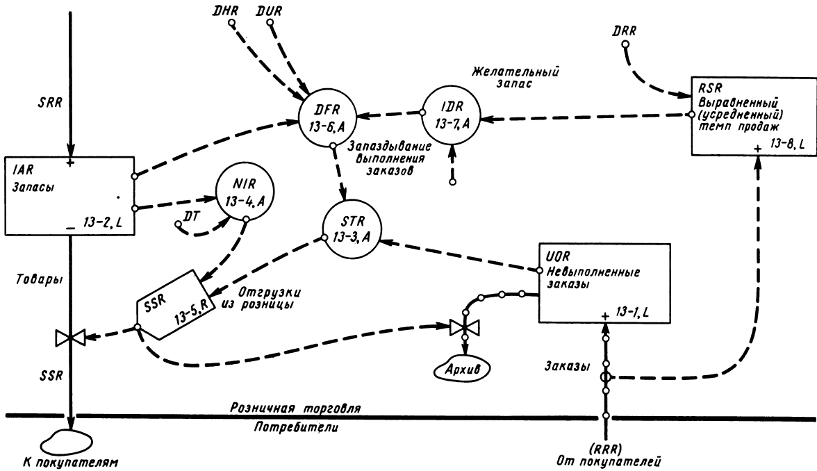
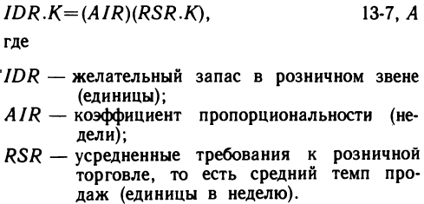
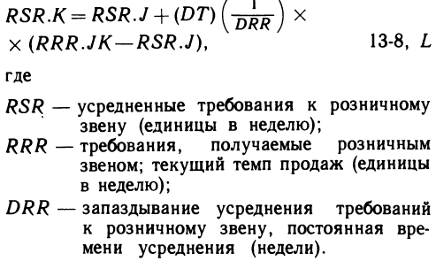
Too many details…

Slide 33
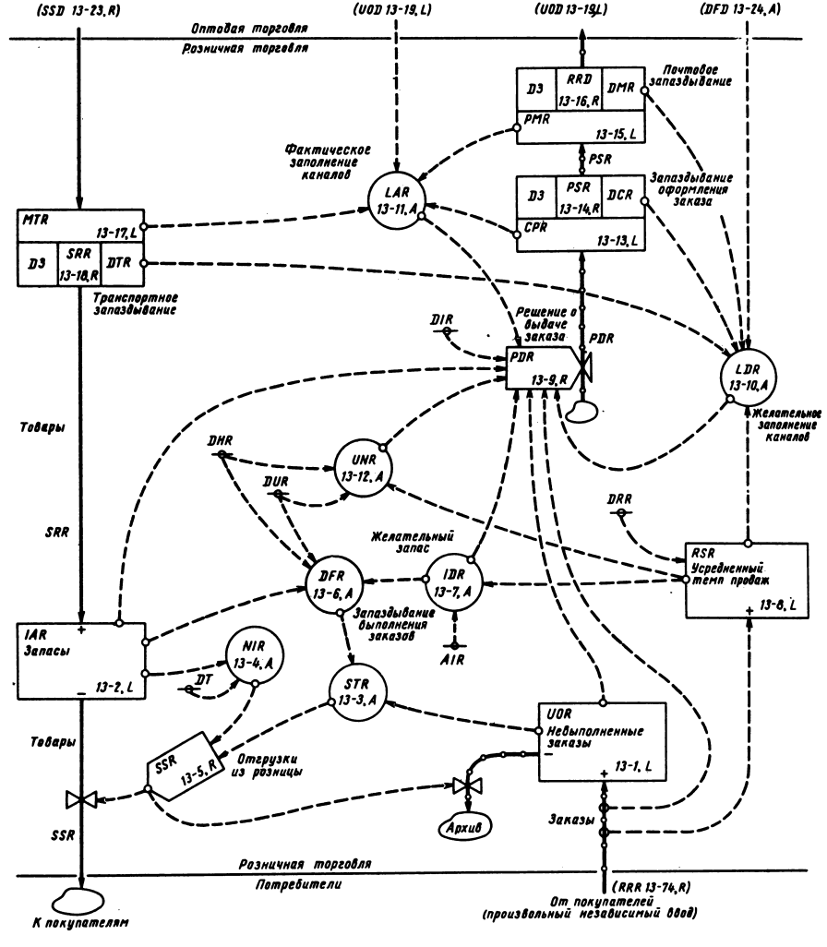
Final model

Slide 34
Laboratory #15

